Slide 1
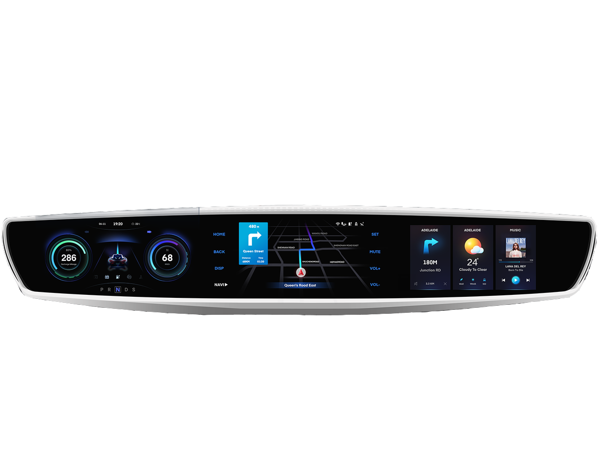
Dashboard of a car
Final Presentation
Human-Computer Interaction
P6
Hugo Paiva de Almeida 93915 LEI
Rui Fernandes 92952 LEI
Carlos Michell Senas 81377 LEI
Notes:
Michell

Slide 2



Introduction
Contextualization
Why this project?
Personal Interest
‹#›
Notes:
Michell

Slide 3



Project Objectives
All utilities
Reduce the risk
Universal System
‹#›
Notes:
Michell

Slide 4

Personas
Needs
Wants
Values
Sean Perkins
Age | Gender | Education | Location
45 years old | Male | Bachelor Degree | Porto
Details
Tangible results
See results before spending money.
Detailed planning
Decisions backed up by analytics or data
‹#›
Notes:
Michell

Slide 5

Personas
Needs
Wants
Values
Isabel Sousa
Age | Gender | Education | Location
18 years old | Female | Bachelor Student | Lisboa
Details
Measurable impact
Something that doesn’t take long to set up
Products that integrate with other existing technology
Time savings
Products that fit easily into her workflow
‹#›
Notes:
Michell

Slide 6
Scenarios
Play a song on bluetooth device
Sean is tired of the car radio and wants to listen to the music on his phone
He connects his phone through bluetooth using the dashboard’s settings menu
He goes to the audio menu and plays “Club Tropicana” through bluetooth
‹#›
Notes:
Rui

Slide 7
Scenarios
Get vehicle status information
Isabel receives a warning on the dashboard with the indication that the tire pressure is low
Taking advantage of this warning, she uses the car's dashboard to check the tire pressure, the car's oil level, amongst other information
‹#›
Notes:
Rui

Slide 8
Scenarios
Call emergency number
Sean is driving at night. As he passes the supermarket, notices that a fire is starting
He quickly decides to call the fire department
Using the dashboard’s phone menu he quickly called the emergency number and reported the incident
‹#›
Notes:
Rui

Slide 9
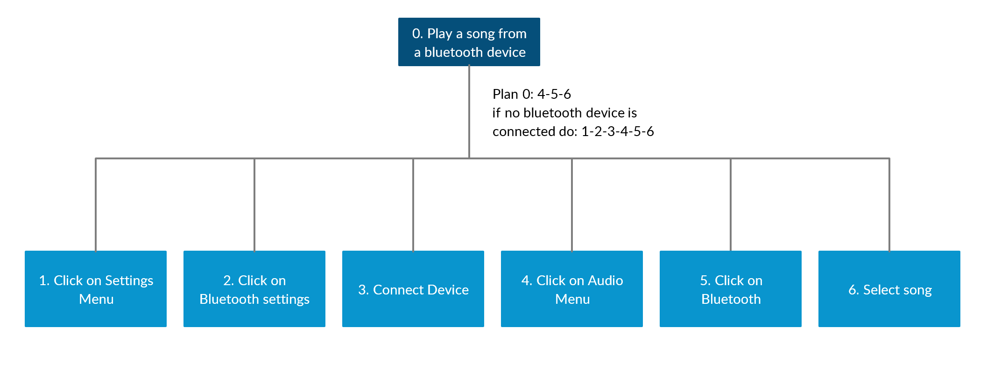
Task
‹#›
Notes:
Rui

Slide 10
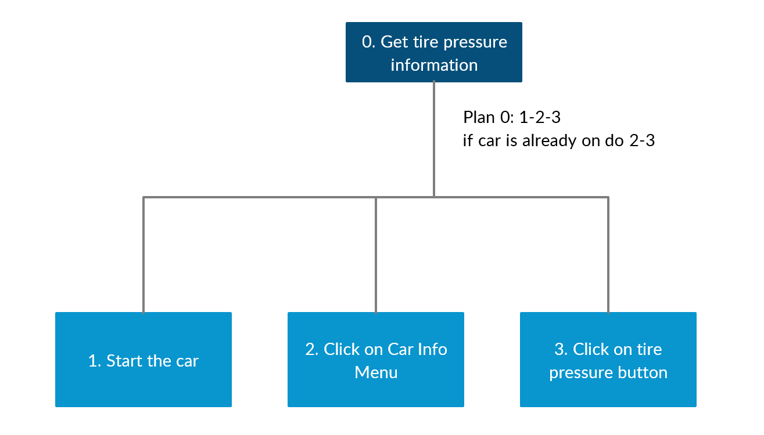
Task
‹#›
Notes:
Rui

Slide 11
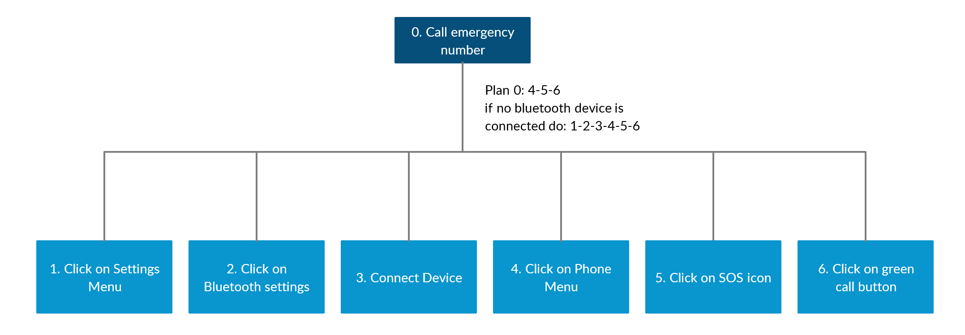
Task
Notes:
Rui

Slide 12
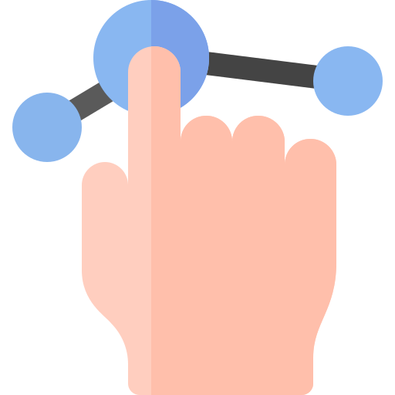


Requirements
Non-Functional
Usability
Availability, Reliability and Maintainability
Performance and Scalability
The application should be easy to learn and use, have a pleasant design and make the user make as few errors as possible
The application should be accessible to the user whenever needed, with low chance of critical failures and when they happen, they should be fixed quickly
The system should have a fast response time and handle different workload while maintaining the performance requirements
‹#›
Notes:
Rui

Slide 13
Requirements
Requirements
Functional
Accomplishable
Not Accomplishable
Inclusion of an app store where the user can download extra applications
External application support e.g. Uber, Skype, TuGas, Shazam, miio, etc.
Internal vehicle information display
Connecting bluetooth devices, namely smartphones with basic phone features
Control of the electrical systems of the doors, windows and air conditioning of the vehicle
Sound system control
Integrated navigation system with map, routes and location search
‹#›
Notes:
Rui

Slide 14
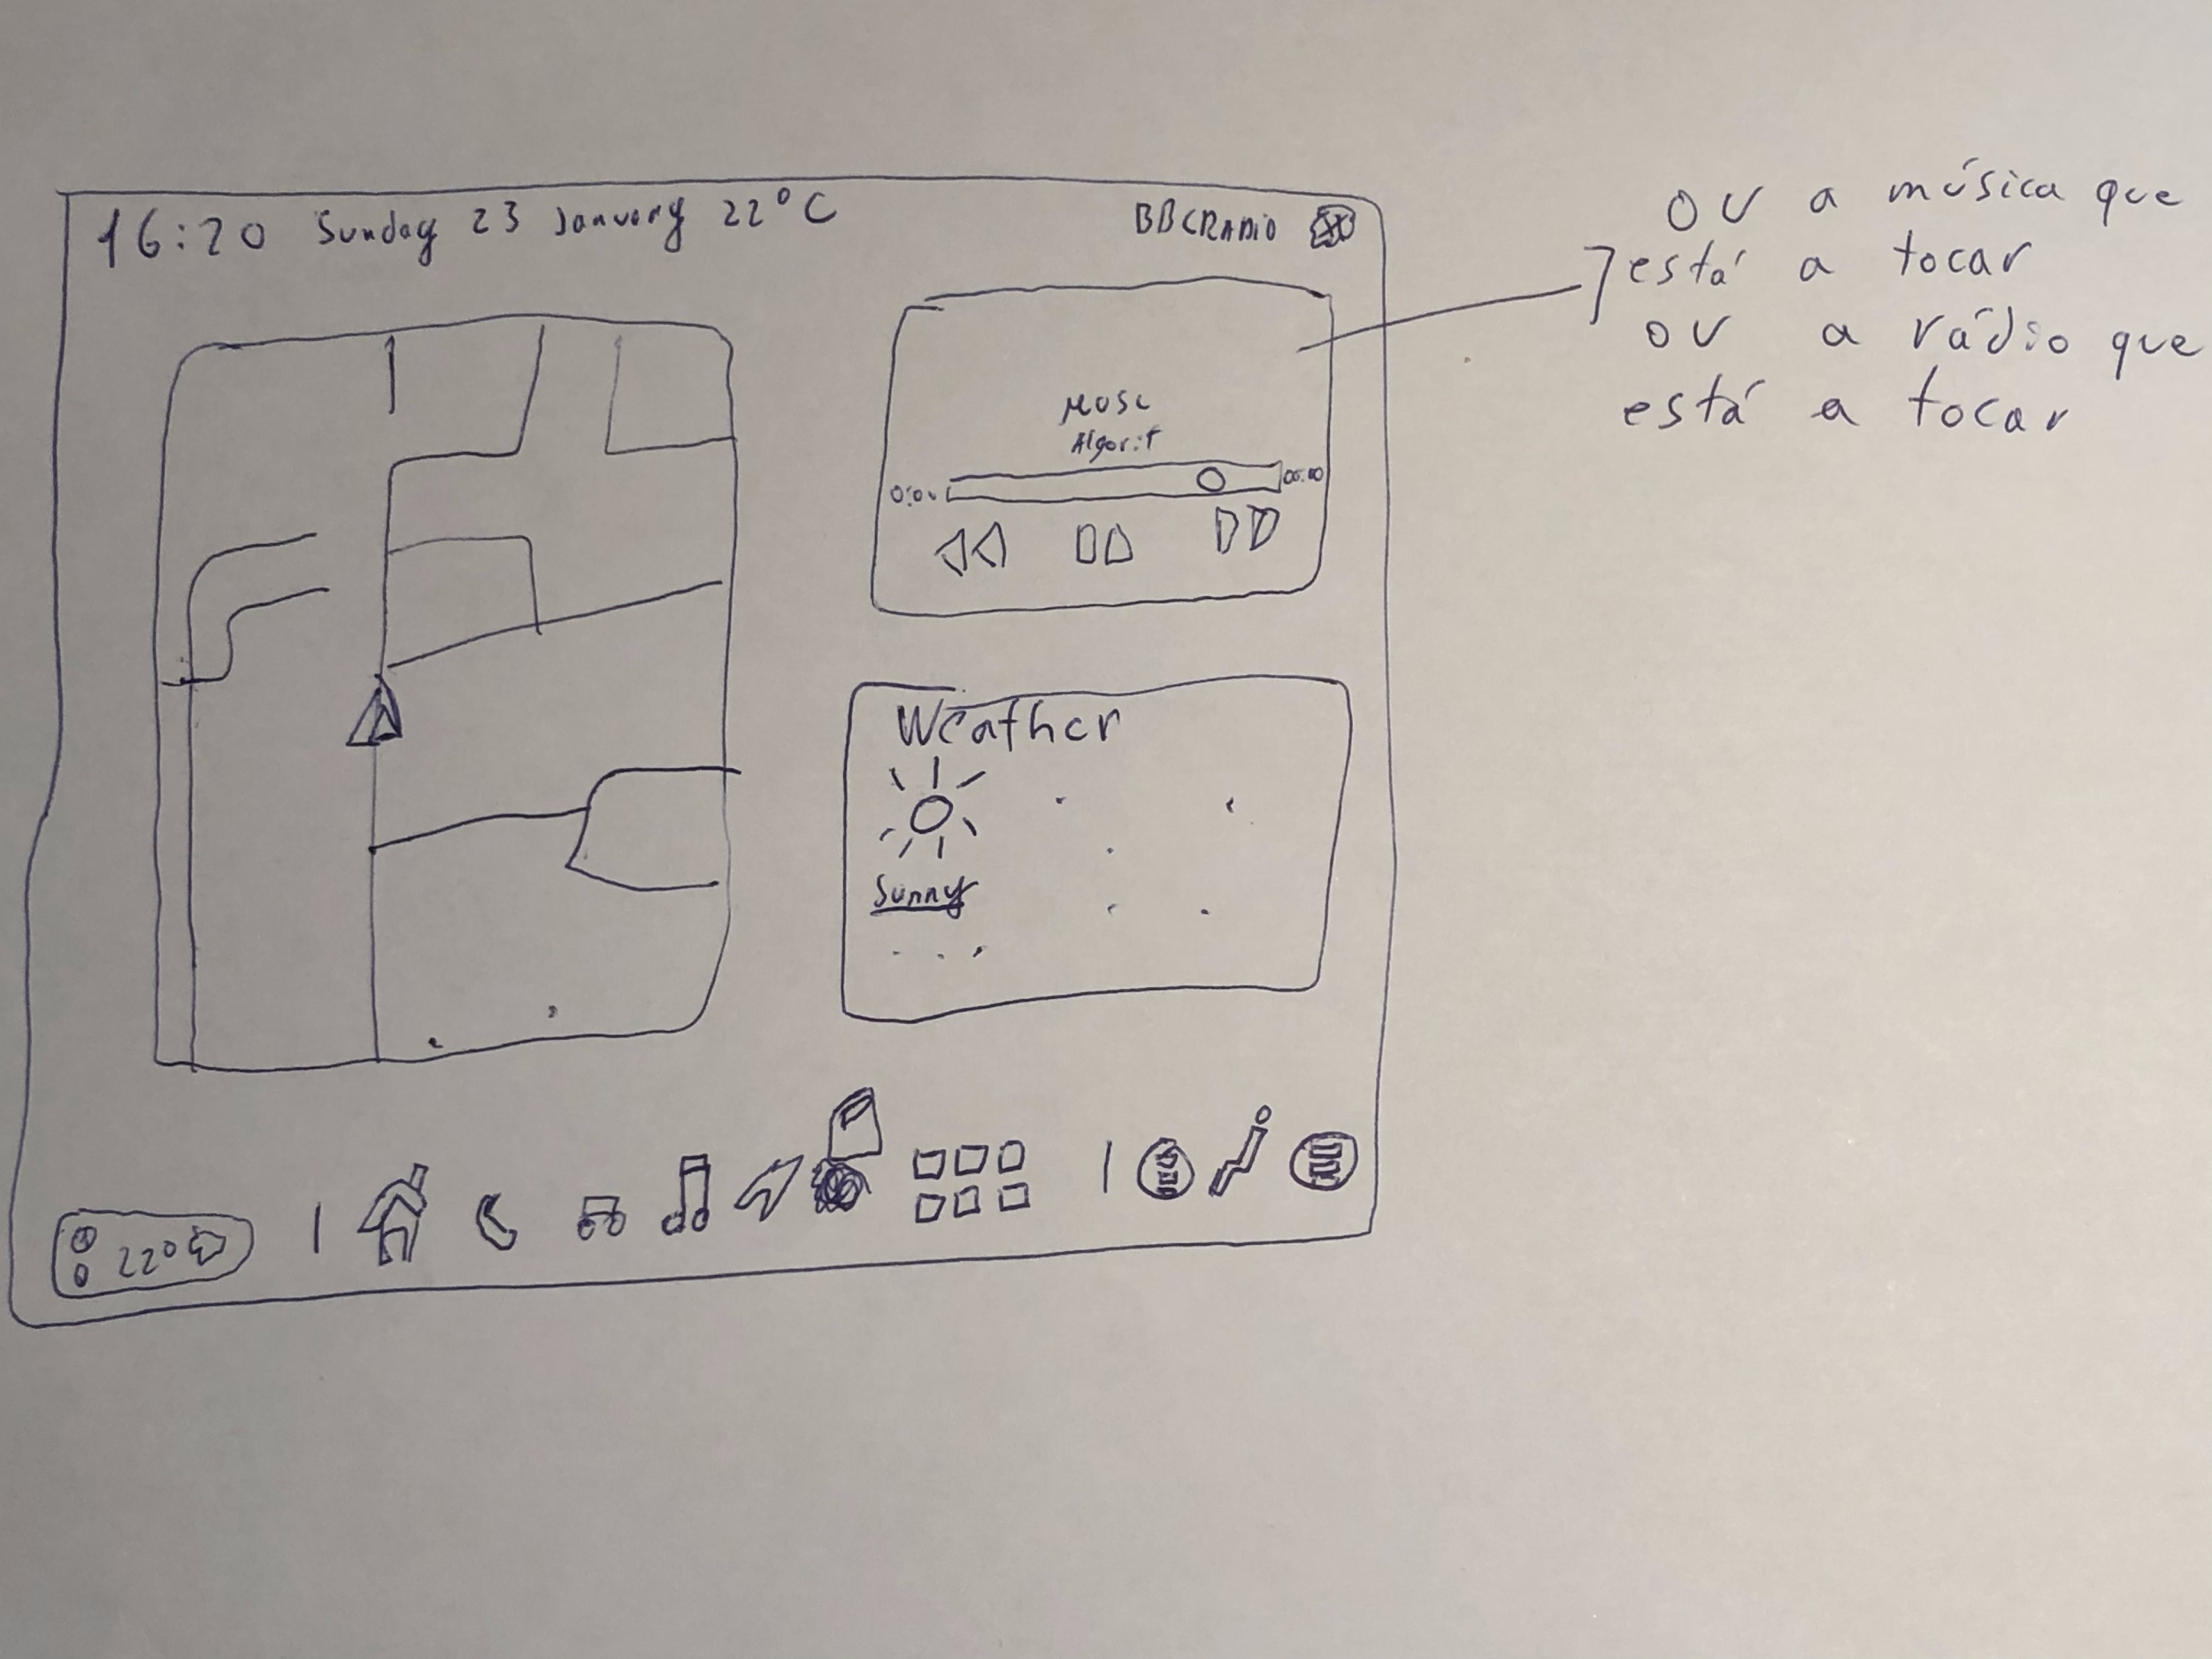
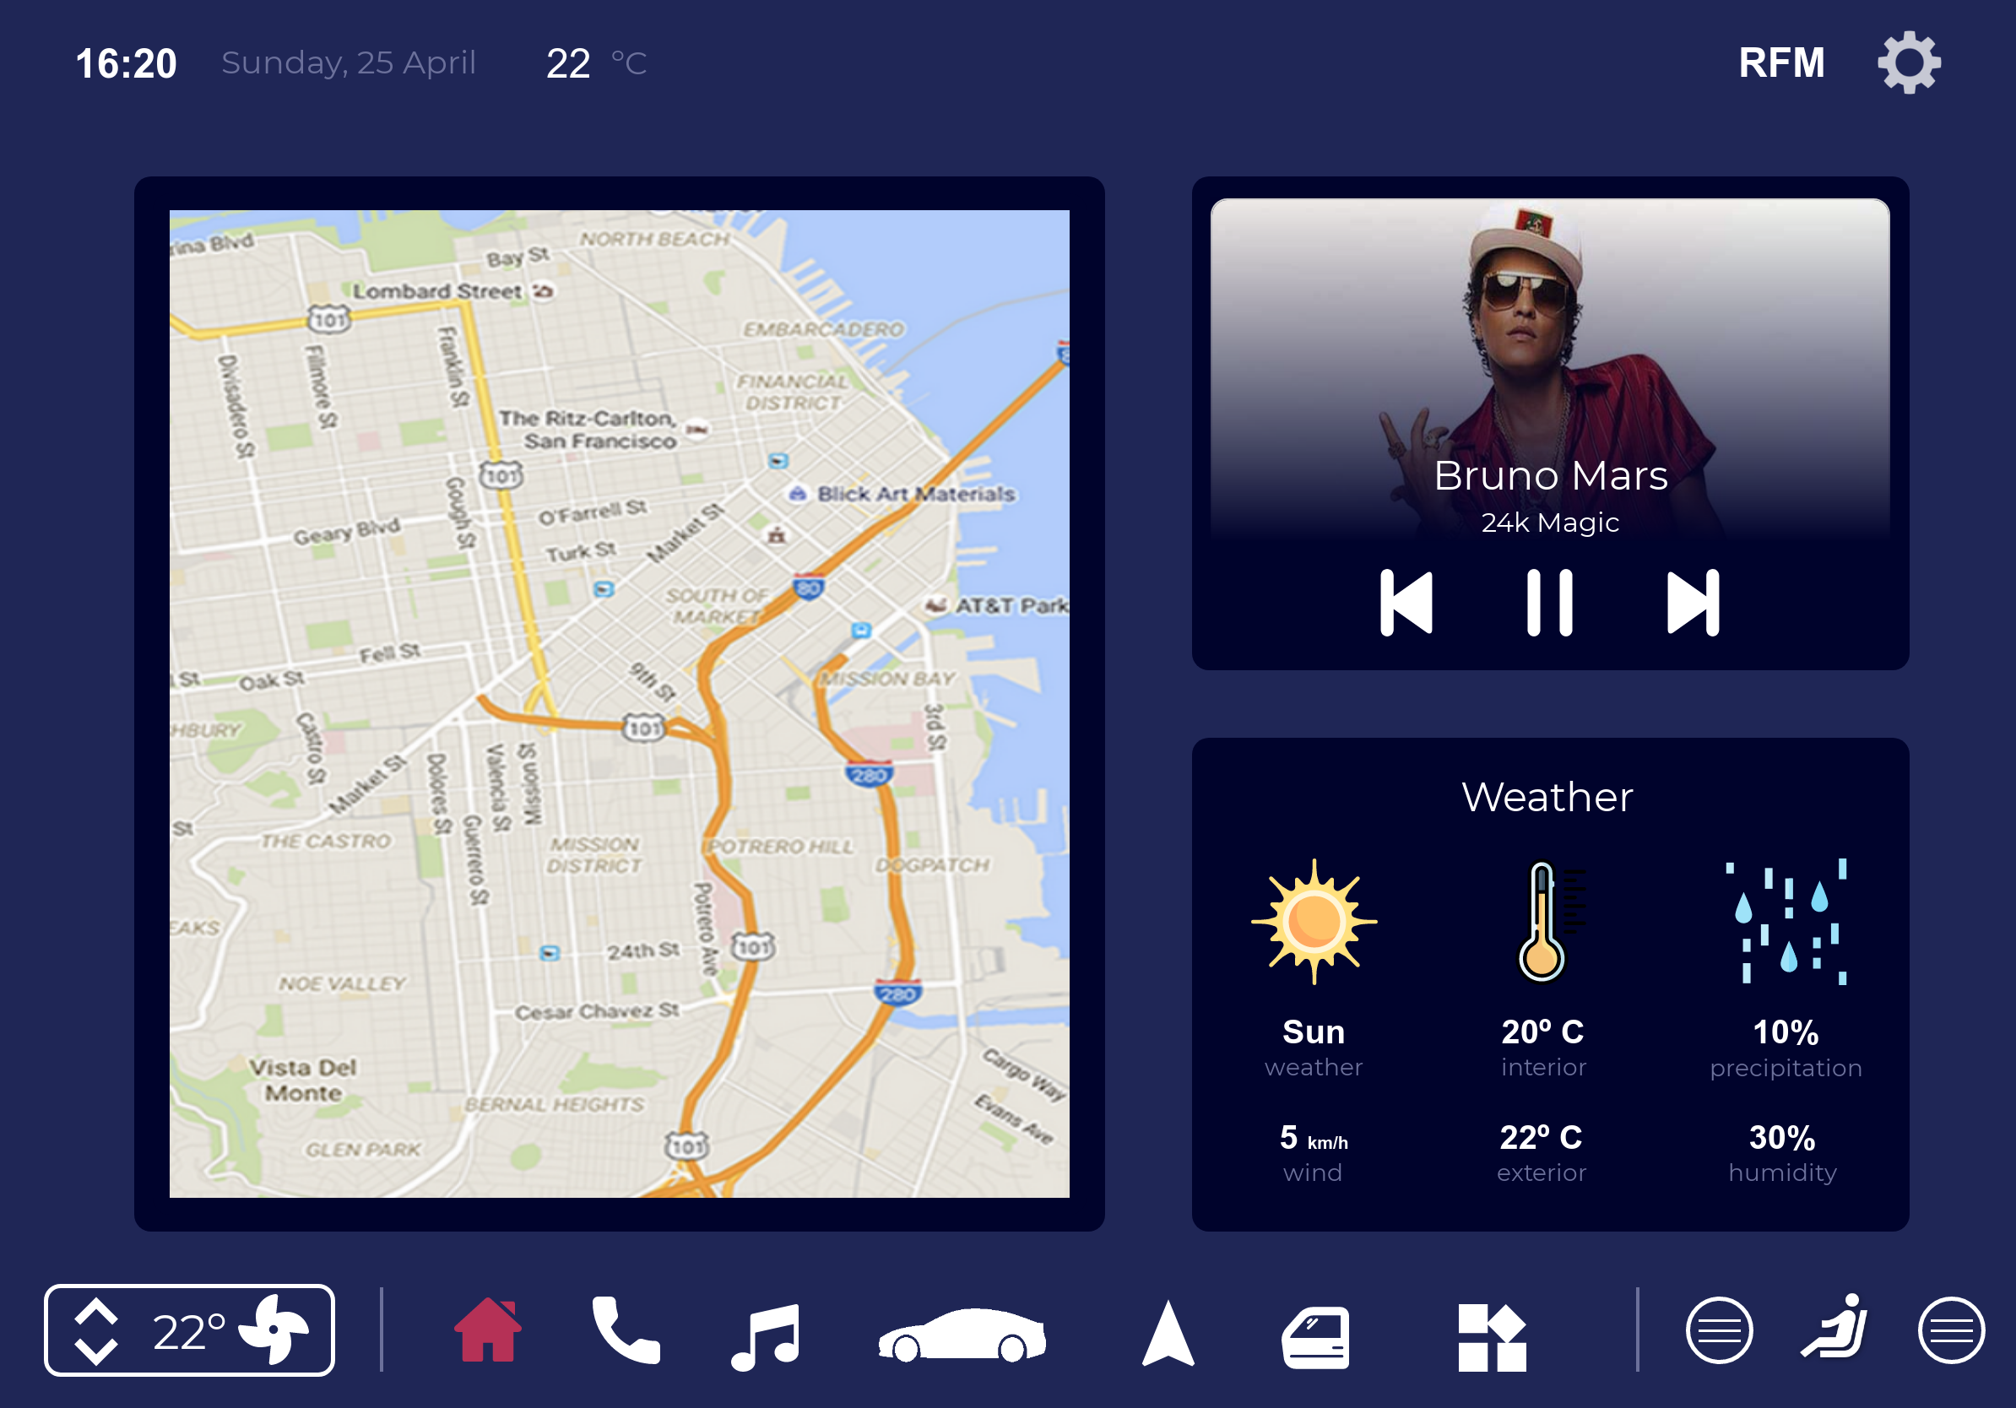
Low Fidelity Prototype
Digital Prototype made with Proto.io
Started with brainstorming in a paper prototype
Transitioned to digital prototype with proto.io
‹#›
Notes:
14-24 Hugo

Slide 15
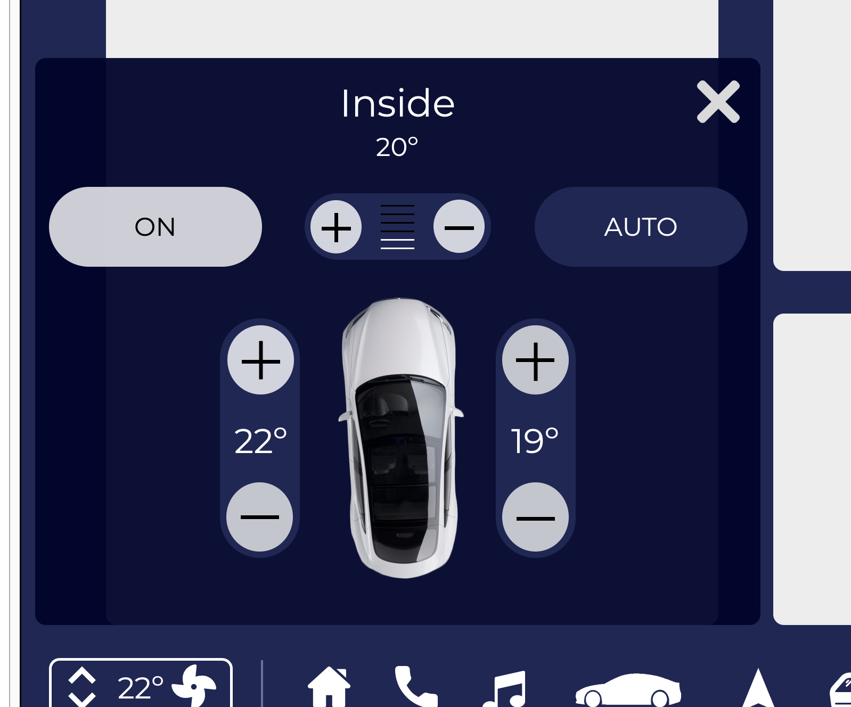
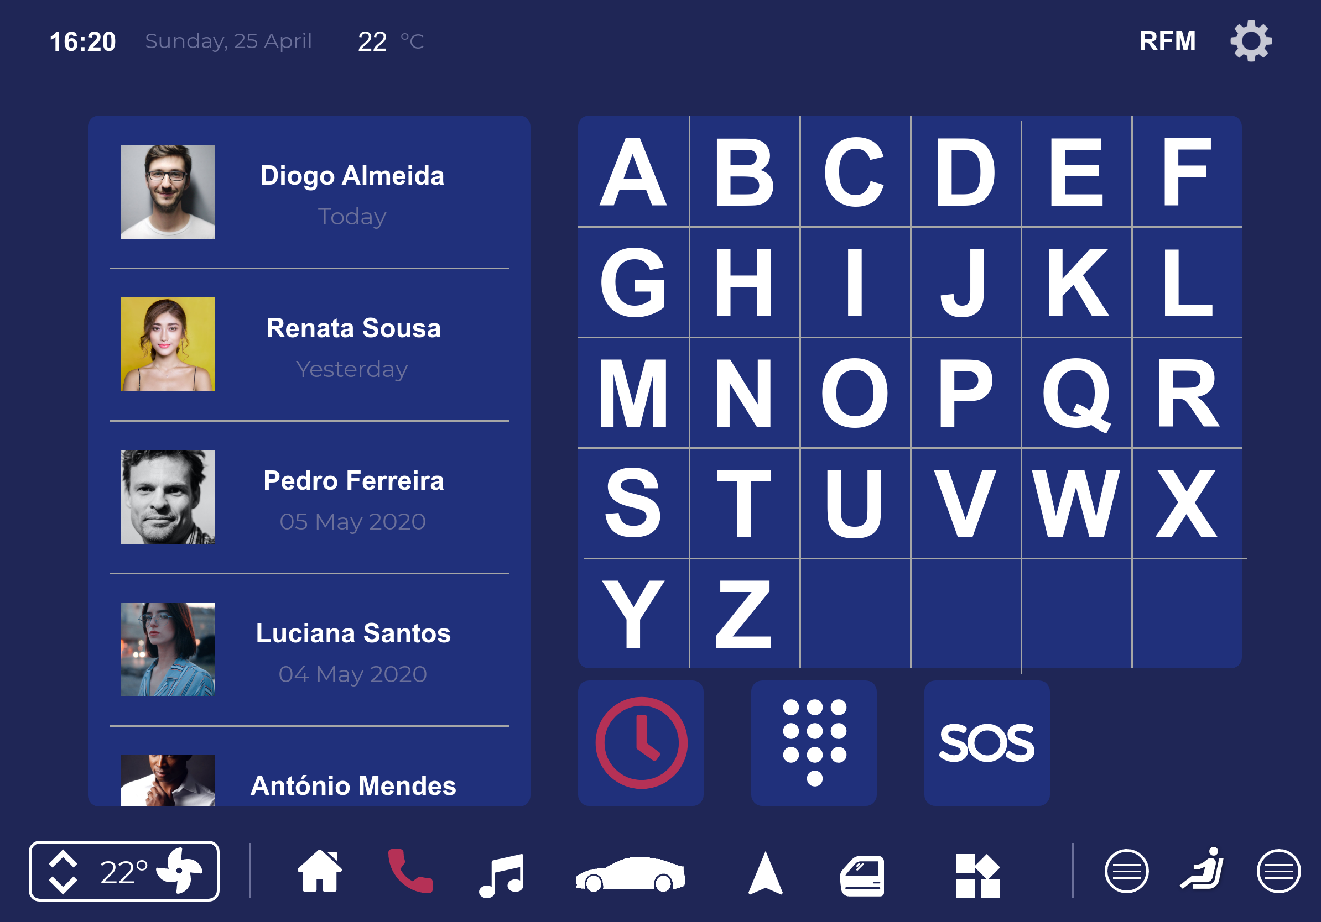
Low Fidelity Prototype
Digital Prototype made with Proto.io
Air control
Phone menu
‹#›

Slide 16
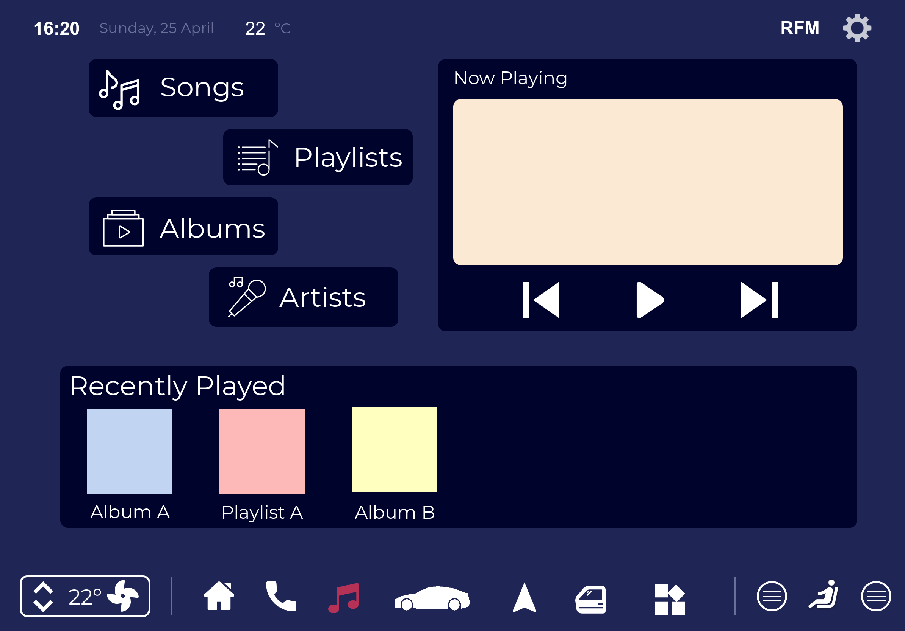
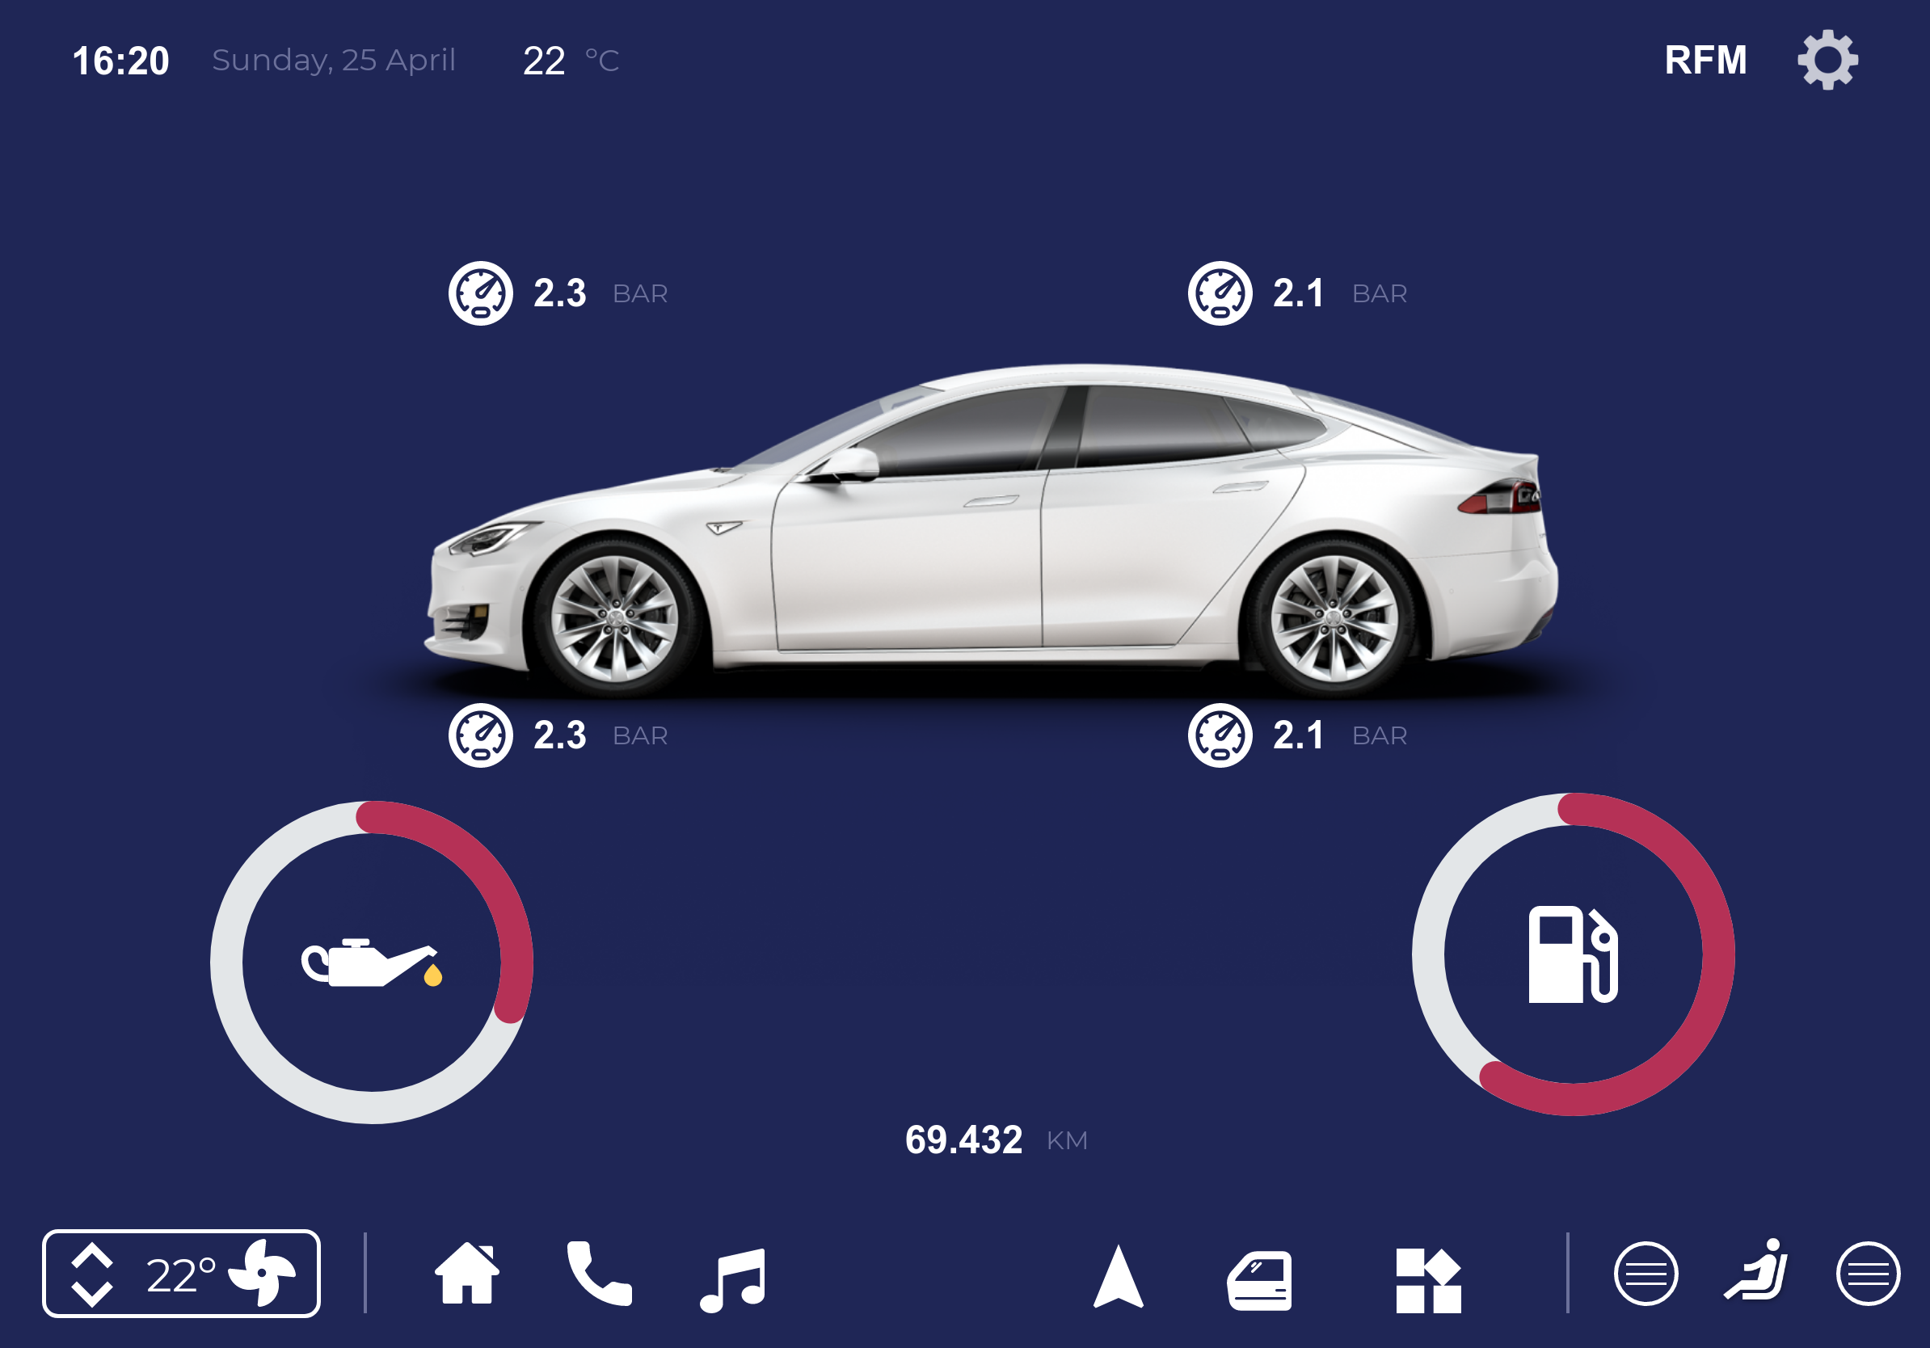
Low Fidelity Prototype
Digital Prototype made with Proto.io
Music menu
Car info menu
‹#›

Slide 17
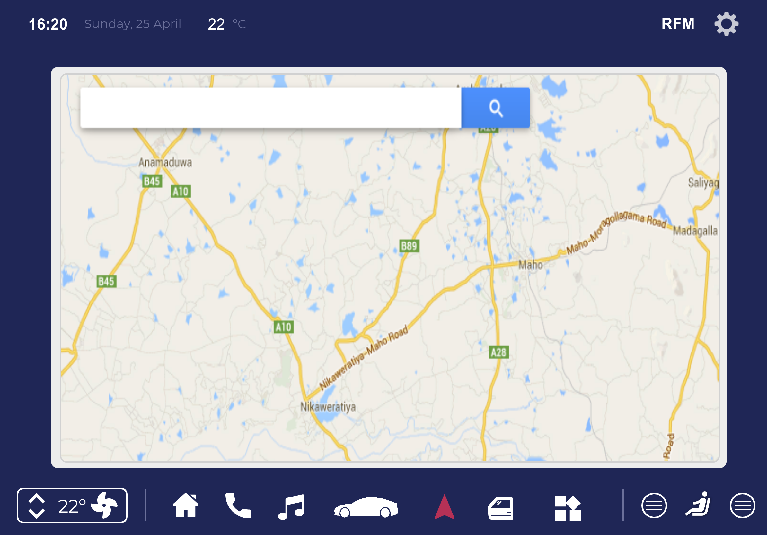
Low Fidelity Prototype
Digital Prototype made with Proto.io
Navigation menu
‹#›

Slide 18
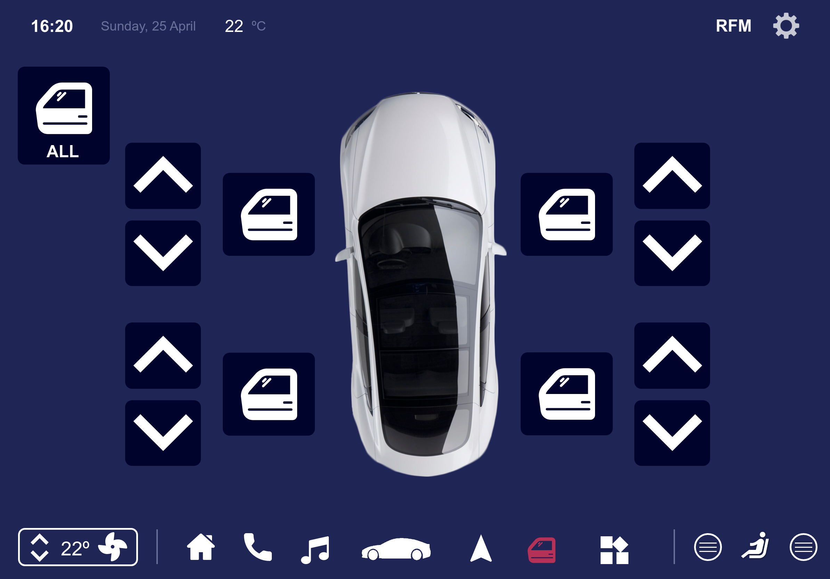
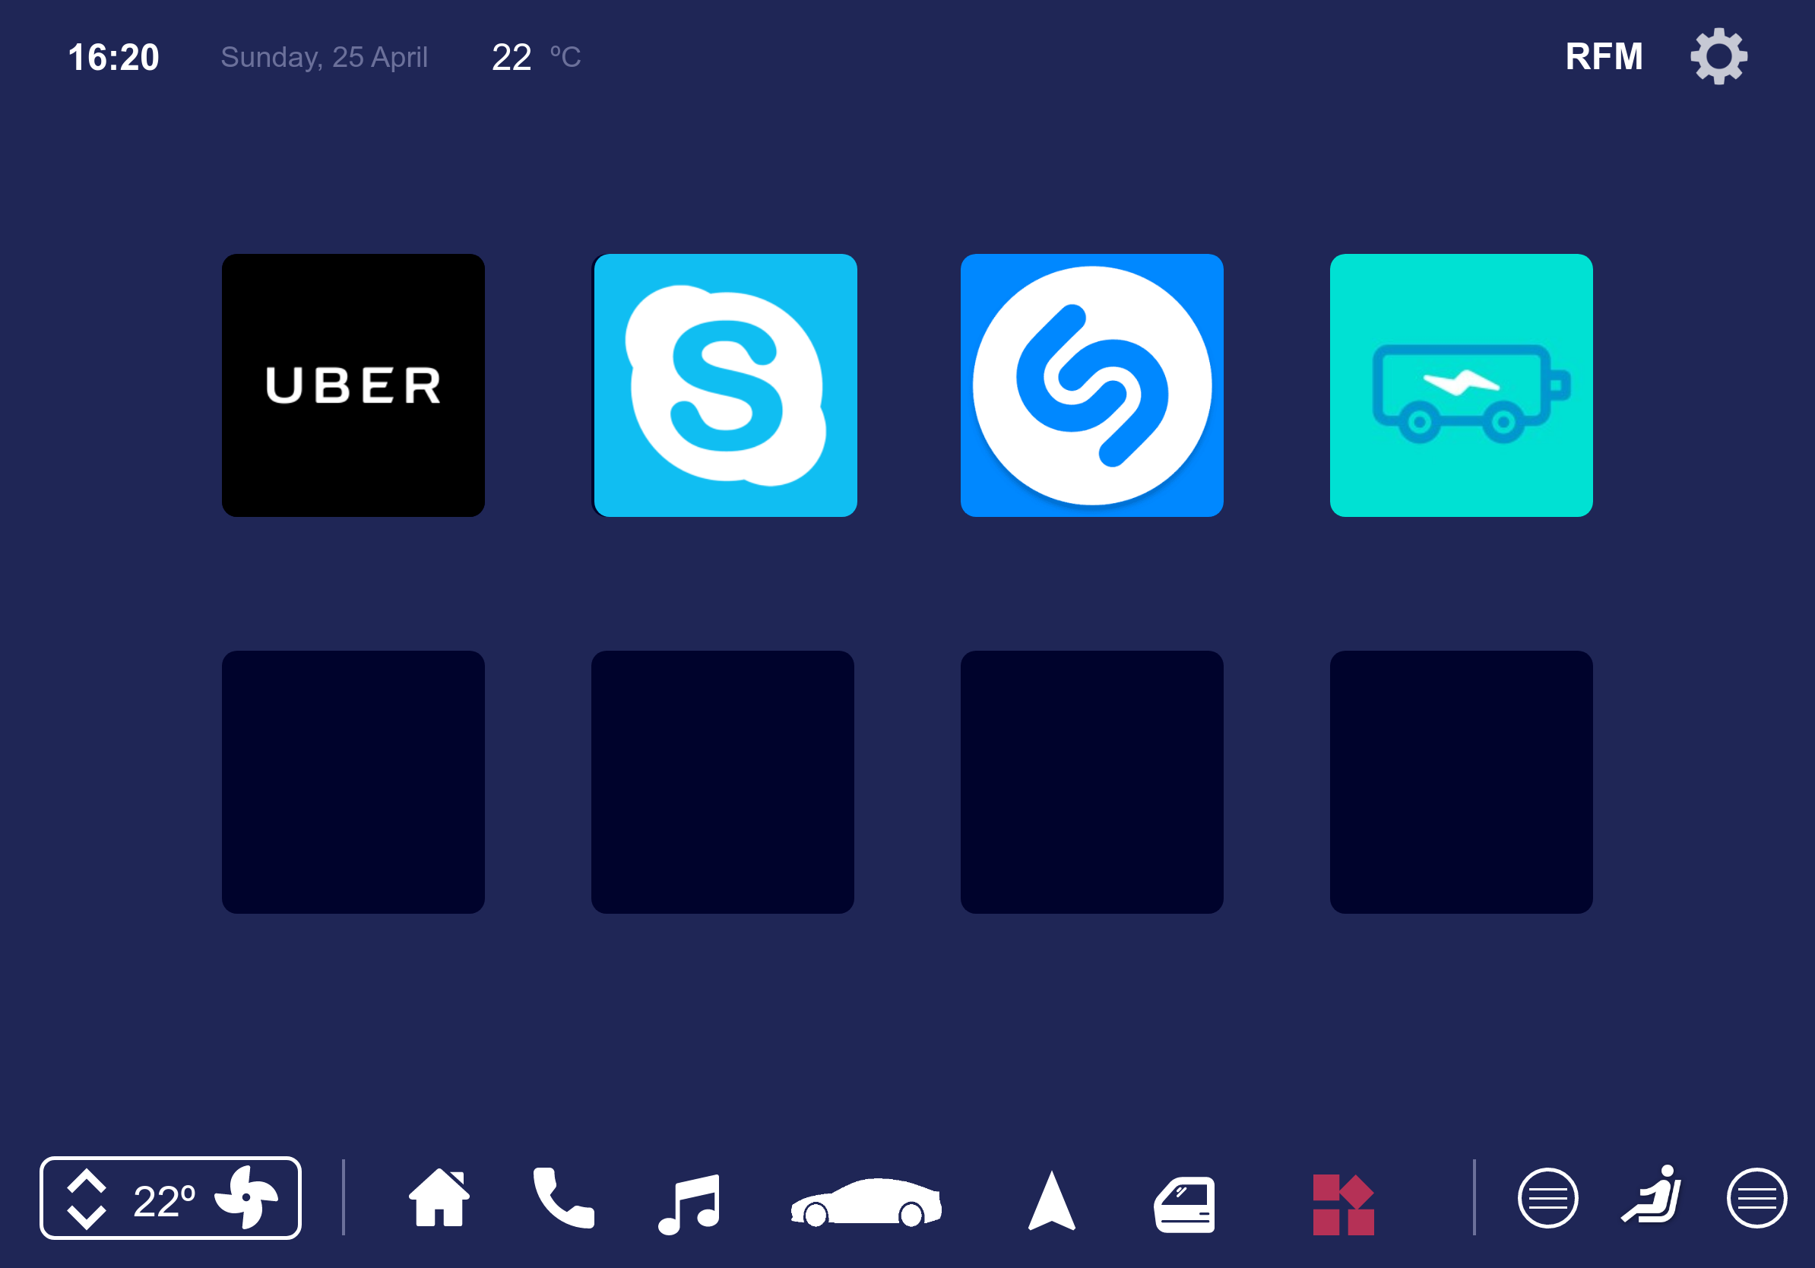
Low Fidelity Prototype
Digital Prototype made with Proto.io
Door menu
Apps menu
‹#›

Slide 19
User Evaluation
Low fidelity Prototype
Used Google forms to make and review the user evaluation based on the documentation provided
The goal was to evaluate the system as a whole (Ease of learning, efficiency of use, error frequency, intuitive design, etc)
Tasks:
Turn on the A/C and raise the temperature on the left side
Increase fan intensity and turn on rear defroster
Call “Alberto Reis” and then call the emergency number
Lock all doors and roll up the driver’s window
Check the car’s fuel
Total of eight (8) participants
‹#›

Slide 20
User Evaluation
High fidelity Prototype
Tested the same tasks
Added new tasks relating to the now implemented music feature:
Play the song “24K Magic” from a bluetooth device (phone) and increase the volume
Increase the ‘Bass’ level on the sound settings menu
Total of six (6) participants
‹#›

Slide 21
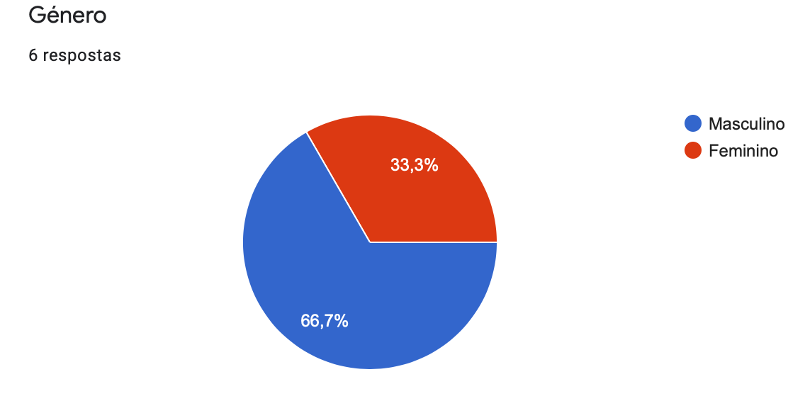
User Evaluation
Results
‹#›

Slide 22
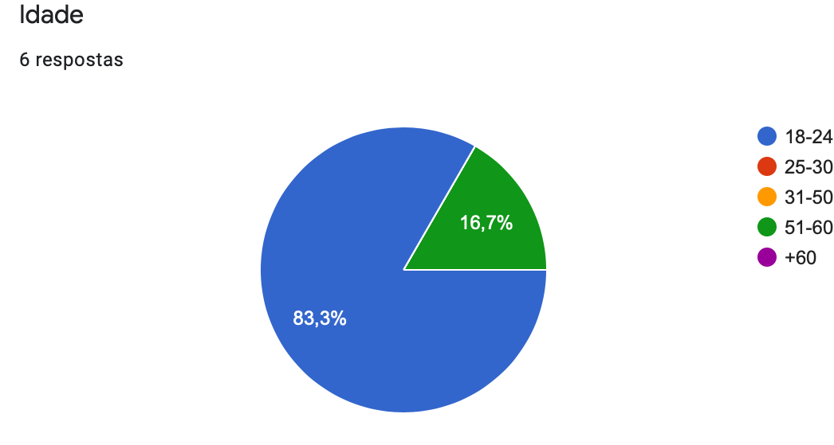
User Evaluation
Results
‹#›

Slide 23
User Evaluation
Results
Task ID | Description | Low Fidelity Prototype | High Fidelity Prototype
1 | Turn on the A/C and raise the temperature on the left side | Easy | Very Easy
2 | Increase fan intensity and turn on rear defroster | Easy | Easy
3 | Call “Alberto Reis” and then call the emergency number | Very Easy | Very Easy
4 | Lock all doors and roll up the driver’s window | Easy | Easy
5 | Check the car’s fuel | Very Easy | Very Easy
6 | Turn on heated seats for the driver’s side | Easy | Very Easy
7 | Play the song “24K Magic” from a bluetooth device (phone) and increase the volume | - | Easy
8 | Increase the ‘Bass’ level on the sound settings menu | - | Very Easy
‹#›
Notes:
Hugo

Slide 24
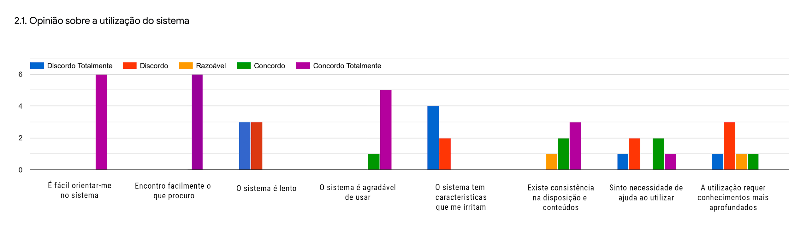
User Evaluation
Results
‹#›
Notes:
Hugo

Slide 25
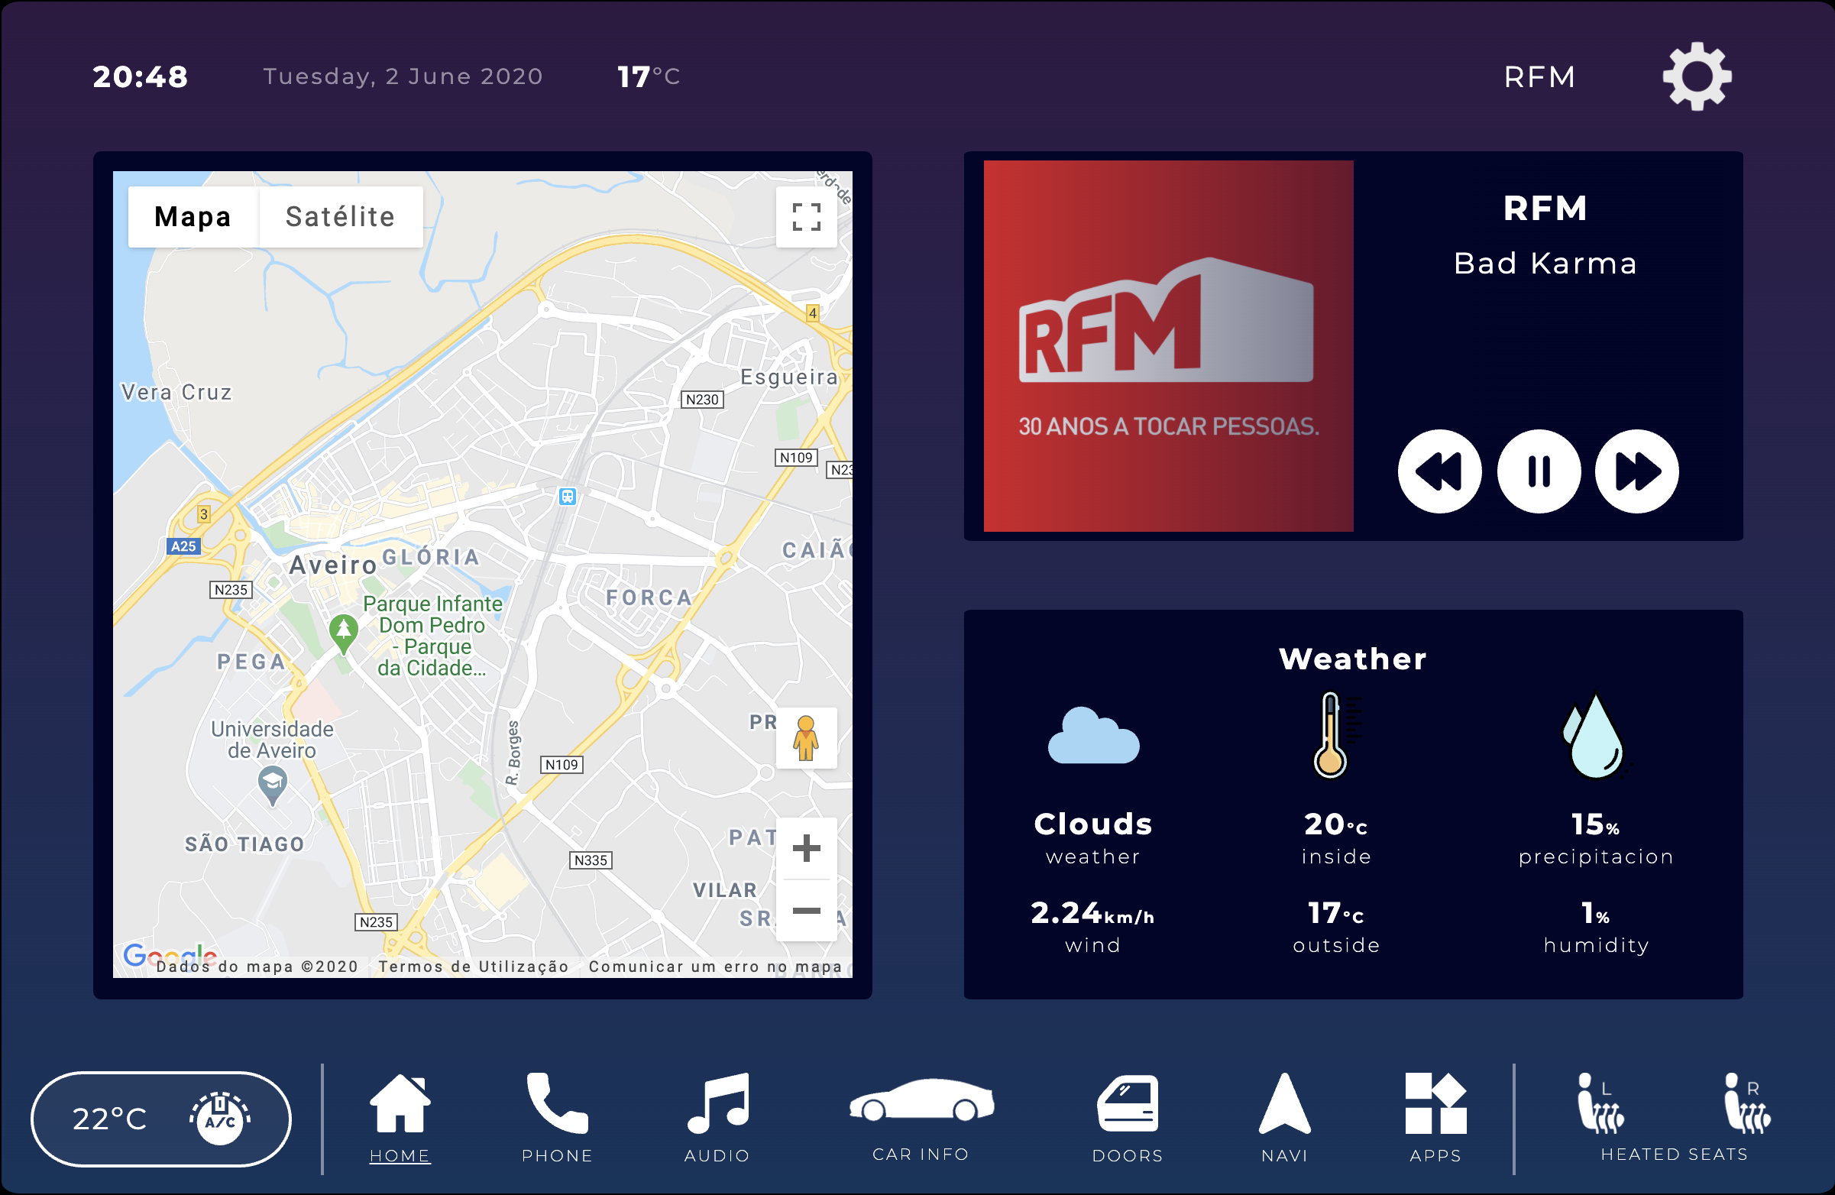
User Evaluation
Update: Labels on navbar icons
Before LFP Usability Test
After LFP Usability Test
‹#›
Notes:
Rui

Slide 26
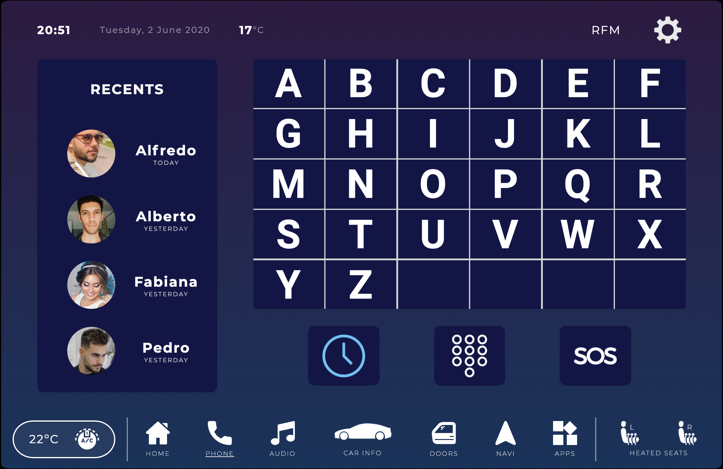
User Evaluation
Update: Identifier on recent calls
Before LFP Usability Test
After LFP Usability Test
‹#›
Notes:
Rui

Slide 27
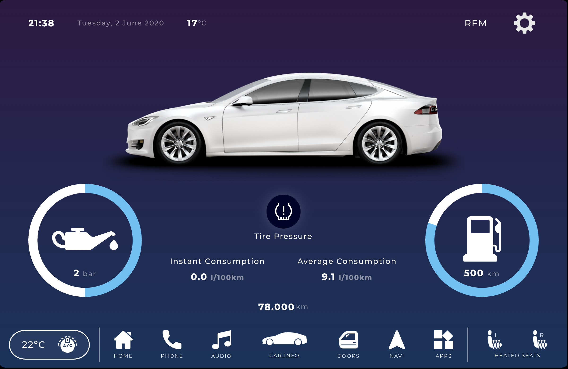
User Evaluation
Update: Side identifier for heated seats
Before LFP Usability Test
After LFP Usability Test
‹#›
Notes:
Rui

Slide 28
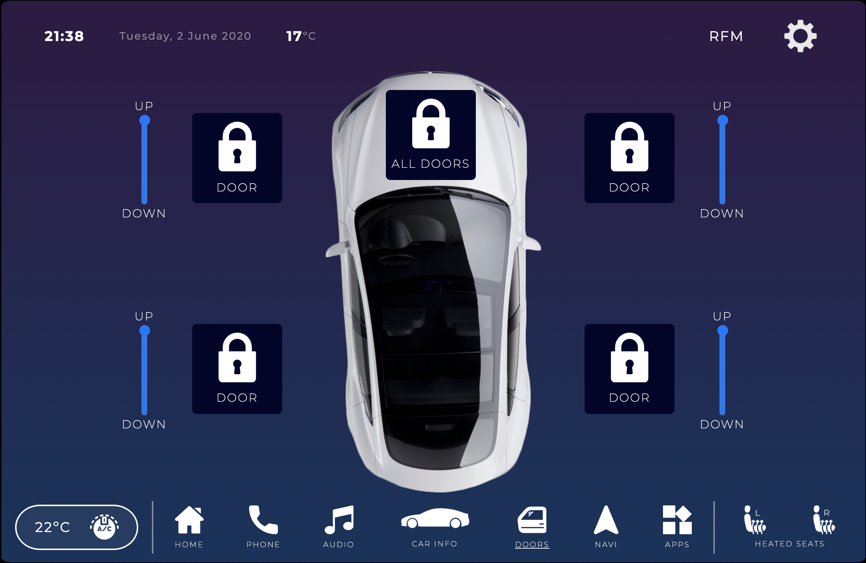
User Evaluation
Update: Change of doors menu (icons, labels)
Before LFP Usability Test
After LFP Usability Test
‹#›
Notes:
Rui

Slide 29
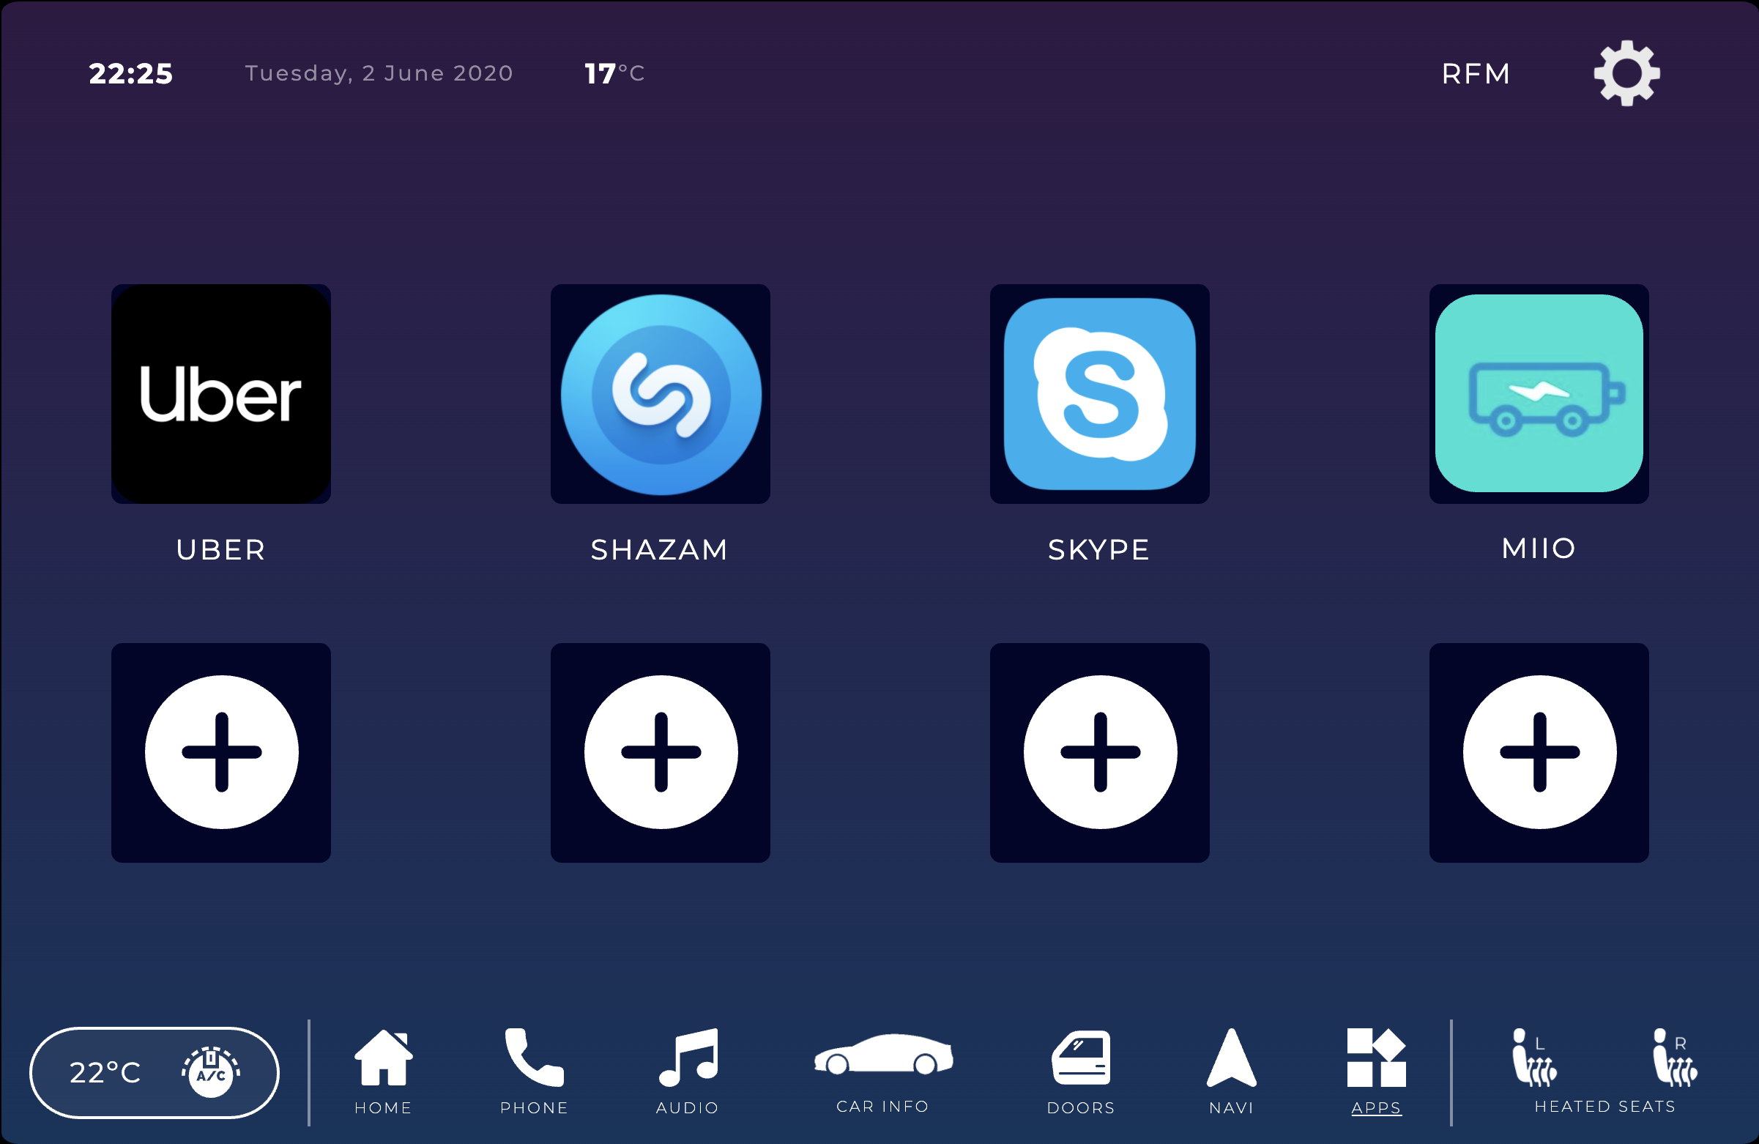
User Evaluation
Update: Better choice of icon for A/C
Before LFP Usability Test
After LFP Usability Test
‹#›
Notes:
Michell

Slide 30
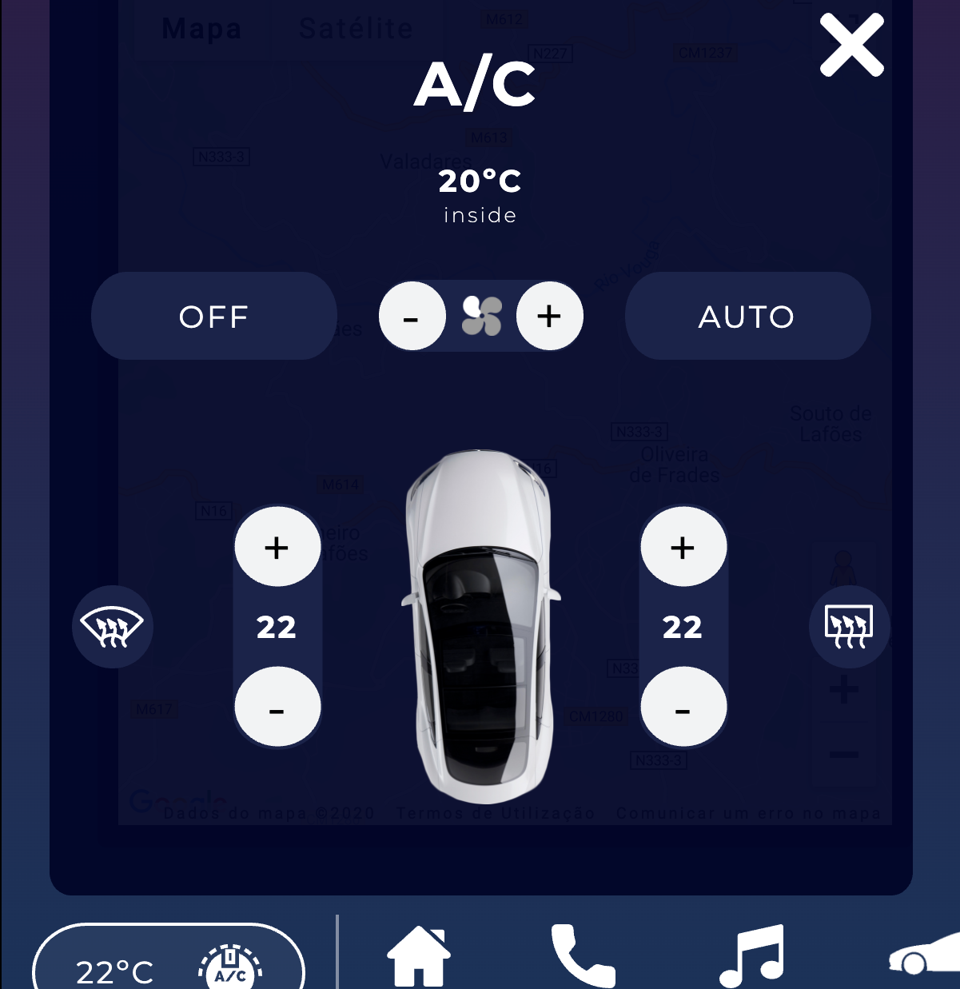
User Evaluation
Update: Better choice of icon for fan intensity
Before LFP Usability Test
After LFP Usability Test
‹#›
Notes:
Michell

Slide 31

User Evaluation
Update: Visual feedback when completing tasks
Before LFP Usability Test
After LFP Usability Test
‹#›
Notes:
Michell

Slide 32
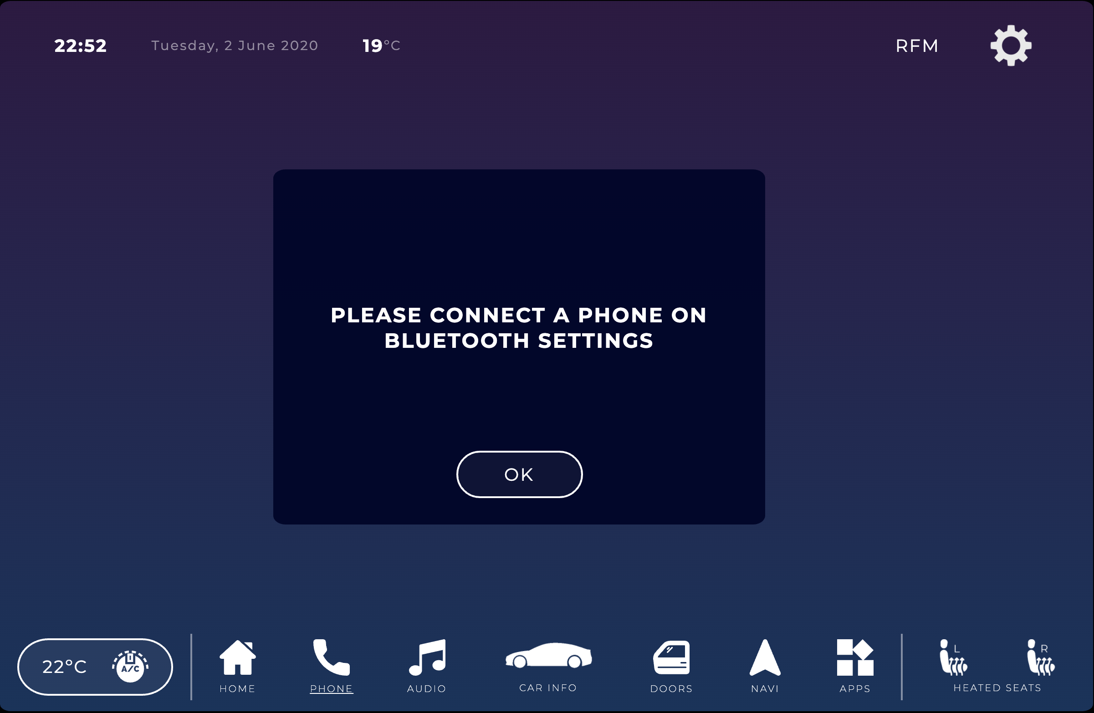
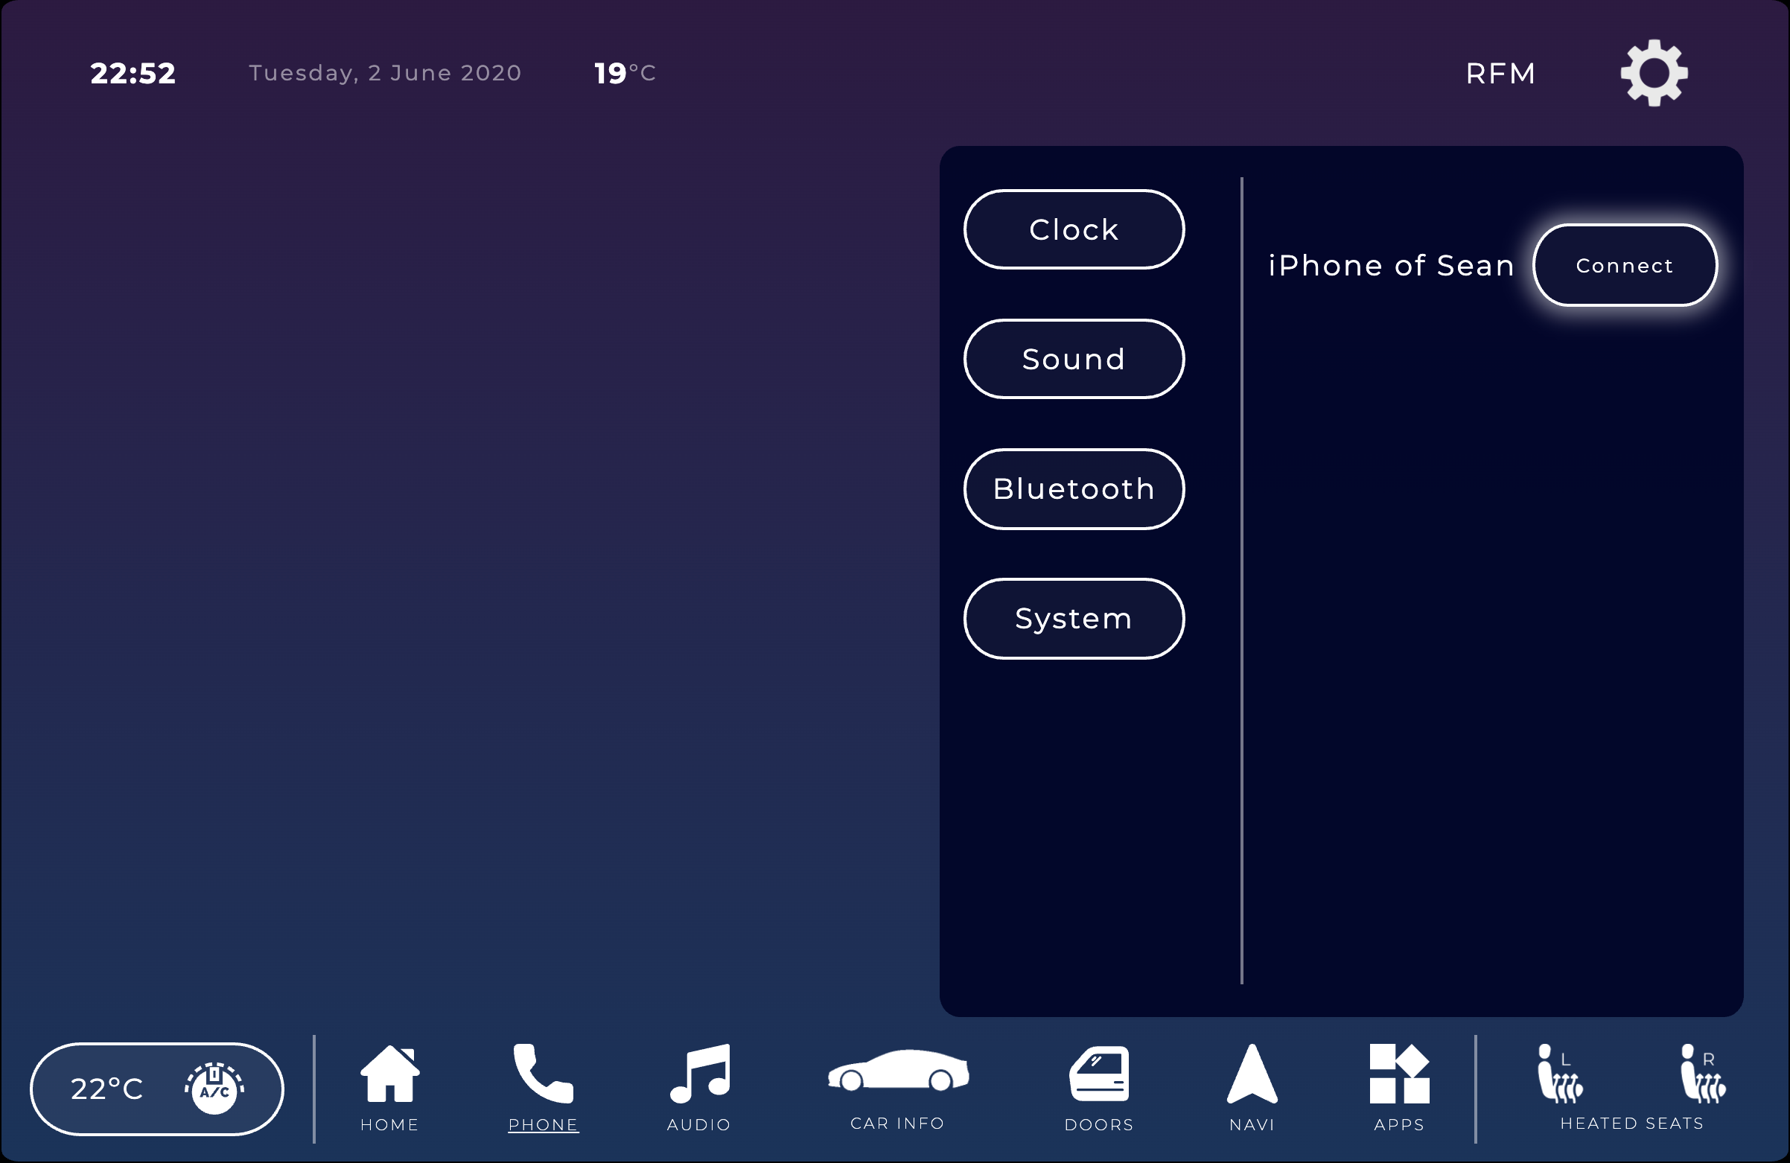
User Evaluation
Update: Open settings when warning of Bluetooth device not connected
Before Usability Test on Functional Prototype
After Usability Test on Functional Prototype
‹#›
Notes:
Michell

Slide 33

Platform Used For Functional Prototype
Website based on HTML, CSS and JavaScript web programming
Prior knowledge on this technologies
External libraries for some functionalities or display:
Swup JS
Maps JavaScript API
ProgressBar JS
‹#›
Notes:
Hugo

Slide 34
Heuristic Evaluation on Functional Prototype
 | Carolina | Orlando | Lucas
 | Severity | Severity | Severity
No button to close settings tab (User control and freedom) | 3 | - | 2
Top bar temperature doesn’t specify if its inside or outside (Consistency and Standards) | 2 | 1 | 1
Color on heated seats is not very noticeable (Aesthetic and minimalist design) | - | - | 1
Notification windows and pop-ups should close when click outside or switching screens (User control and freedom) | - | 2 | 1
‹#›
Notes:
Rui

Slide 35
Demo
‹#›

Slide 36




Future Work
More feedback and animations throughout the interface
Support for external apps and app store
Waze implementation on navigation menu
Developing a physical prototype integrated into a real car
‹#›
Notes:
Rui

Slide 37
Acknowledgements
Special thanks to all the people that helped us making this possible!
Hugo Paiva de Almeida 93915 LEI - 33.33%
Rui Fernandes 92952 LEI - 33.33%
Carlos Michell Senas 81377 LEI - 33.33%
‹#›
Notes:
Michell

